Slide 1

Voice Control Home Automation System Using Arduino and HC05
group 11
Class: bcs15-b

Slide 2
Group members
Mohamed Ilyaas Mohamud
Hussien Abdikariin Ali
Hanad Ahmed Mohamed

Slide 3
Topics covered
Introduction
Problem Statement
Why Voice-Controlled Home Automation?
System Components
How the System Works

Slide 4
Introduction
Voice-Controlled Home Automation using Arduino and Bluetooth. This project lets you control home devices like lights and fans by using voice commands.
Smart home technology is becoming more popular, and voice control makes managing our homes easier and more convenient. Our goal was to create a system that is simple, affordable, and helpful, especially for people who may have difficulty moving around.”

Slide 5

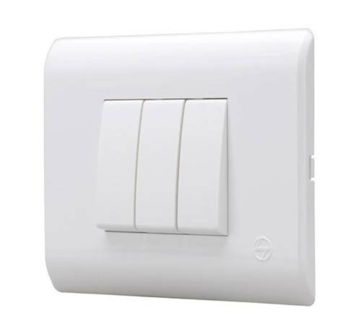
Problem Statement
Many people face challenges when controlling home devices manually. For example, people with disabilities or those who are busy might find it difficult to use switches. We wanted to solve this problem by creating a hands-free way to control home devices easily

Slide 6
Why Voice-Controlled Home Automation?
The main goals of our project are
To create a system that lets you control home devices using voice commands.
To use Bluetooth for wireless control.
To make the system easy to use, low-cost, and helpful for daily life.

Slide 7
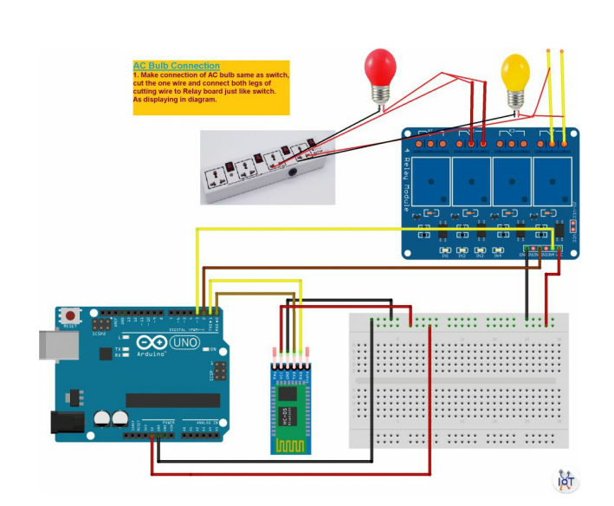
System Components
Arduino Uno – a small computer that controls everything.
HC-05 Bluetooth Module – for wireless communication between your phone and Arduino.
Relay Module – to turn devices like lights and fans ON or OFF.
Smartphone with a Voice App – to send voice commands.
Devices home

Slide 8
How the System Works
You give a voice command through a smartphone app, like ‘Turn on the light.’
The phone sends this command to the HC-05 Bluetooth module.
The HC-05 module sends the command to the Arduino Uno.
The Arduino reads the command and turns the relay ON or OFF.
The relay controls the device, like a light or a fan, and it turns ON or OFF.”
Example:
If you say, ‘Turn on the fan,’ the fan turns ON.
If you say, ‘Turn off the light,’ the light turns OFF.

